Slide 1
Yield Curve Bootstrapping
Trades & Analytics – TA004
With Excel and C++ Example
Author(s): Alexis David
Speaker(s): Alexis David
Editor(s): Alexis David

Slide 2
Table of Content
First Video (this video)
Chapter 1 – General Principles
Swap vs Bond Market
OIS Introduction
Bootstrapping High-Level Principle
Chapter 2 – Bootstrapping Theory
Interest Rates Types
Schedule Definition
Instruments Definition (Deposit & OIS)
Bootstrapping Explanation
Second Video
Chapter 3 – Bootstrapping Application
(Excel Spreadsheet Walkthrough)

Slide 3
a) Swap vs Bond Market
Swap Market Advantages:
More Liquidity
More Depth
Better Correlation
Less Government Dependant
No Cash Exchanged at T0 (Swap are entered at par)
No Risk of Default (only counterparty risk)
More Standardized
More Accurate
Better Real-World Market Representation
Better Hedging Instruments
I. General Principles

Slide 4
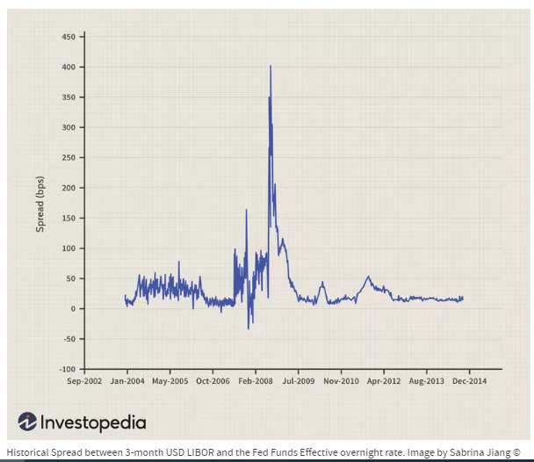
b) OIS - Introduction
Market standard for discounting collateralized cashflows
Best available proxies for risk-free rates
Recommended by academics (e.g. Hull & White) for derivatives valuation
Allow borrowing/investing at a given reference rate on every single date
From Oct-2019 to Dec-2021, EONIA = €STR + 8.5 bps
From 1-Jan-2022, EONIA got discontinued
Overnight – Swap Spread History
I. General Principles

Slide 5




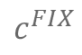


c) Bootstrapping – High-Level Principle
Instrument Selection
Instrument Pricing
Instrument Calibration
$$c^{FIX}$$
Regression Target
Next Instrument
$$\hat{c^{FIX}}=c^{FIX}$$
$$\hat{c^{FIX}}≠c^{FIX}$$
Root-Finding
Algorithm
I. General Principles

Slide 6
II Bootstrapping Theory
a) Interest Rates Types

Slide 7

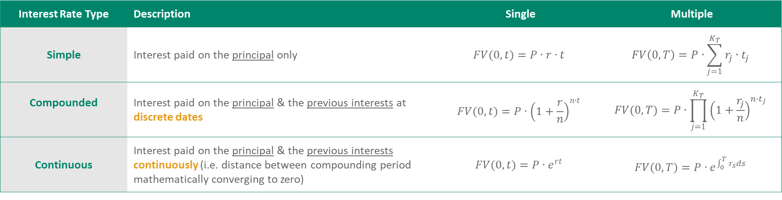
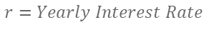

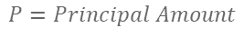

a) Interest Rates Types
$$FV\left(0,t\right)= Future Value at time t$$
Compounding Period | n
Yearly | 1
Semi-Annually | 2
Quarterly | 4
Monthly | 12
Daily* | 360
$$P=Principal Amount$$
$$r=Yearly Interest Rate$$
$$\lim_{N→∞}{{\left(1+\frac{1}{N}\right)}^{N}=e}$$
$$\lim_{n→∞}{{\left(1+\frac{r}{n}\right)}^{n∙t}=e^{rt}}$$
REMINDER
$$⇒$$
$$n=Number of Compounding Periods per year$$
$$t=Accrual Time of one period (in Years)$$
$$T=Accrual Time over multiple periods (in Years)$$
$$K_{T}=Number of compounding Periods over T$$
*Set by convention
Interest Rate Type | Description | Single | Multiple
Simple | Interest paid on the principal only | $$FV(0,t)=P∙r∙t$$ | $$FV\left(0,T\right)=P∙\sum_{j=1}^{K_{T}}{r_{j}∙t_{j}}$$
Compounded | Interest paid on the principal & the previous interests at discrete dates | $$FV(0,t)=P{∙\left(1+\frac{r}{n}\right)}^{n∙t}$$ | $$FV(0,T)=P∙\prod_{j=1}^{K_{T}}{{\left(1+\frac{r_{j}}{n}\right)}^{n∙t_{j}}}$$
Continuous | Interest paid on the principal & the previous interests continuously (i.e. distance between compounding period mathematically converging to zero) | $$FV(0,t)=P∙e^{rt}$$ | $$FV(0,T)=P∙e^{\int_{0}^{T}{r_{s}ds}}$$
II. Bootstrapping Theory

Slide 8
II Bootstrapping Theory
b) Schedule Definition

Slide 9
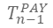
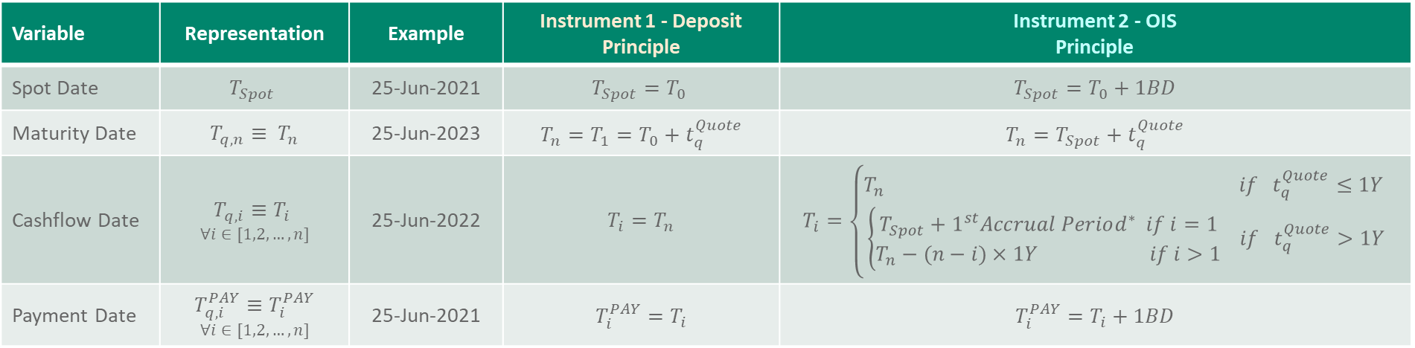
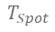
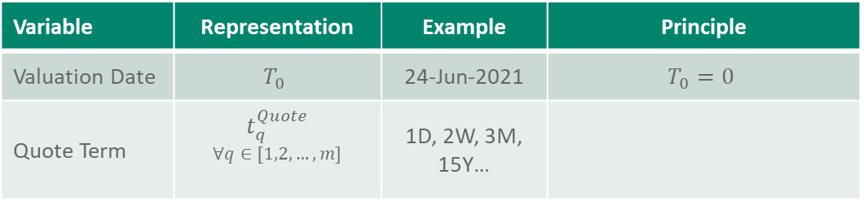
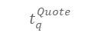
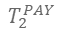
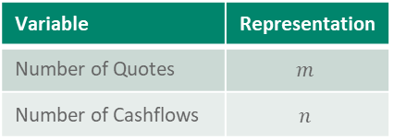
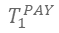
b) Schedule Definitions
Variable | Representation
Number of Quotes | $$m$$
Number of Cashflows | $$n$$
General Definitions
Variable | Representation | Example | Principle
Valuation Date | $$T_{0}$$ | 24-Jun-2021 | $$T_{0}=0$$
Quote Term | $$t_{q}^{Quote}$$ $$∀q∈[1,2,…,m]$$ | 1D, 2W, 3M, 15Y…
$$t_{q}^{Quote}$$
$$T_{0}$$
$$T_{Spot}$$
$$T_{1}$$
$$T_{1}^{PAY}$$
$$T_{2}$$
$$T_{2}^{PAY}$$
…
$$T_{n−1}$$
$$T_{n−1}^{PAY}$$
$$T_{n}$$
$$T_{n}^{PAY}$$
Instrument Specific Definitions
Variable | Representation | Example | Instrument 1 - Deposit Principle | Instrument 2 - OIS Principle
Spot Date | $$T_{Spot}$$ | 25-Jun-2021 | $$T_{Spot}=T_{0}$$ | $$T_{Spot}=T_{0}+1BD$$
Maturity Date | $${T_{q,n}≡ T}_{n}$$ | 25-Jun-2023 | $$T_{n}=T_{1}=T_{0}+t_{q}^{Quote}$$ | $$T_{n}=T_{Spot}+t_{q}^{Quote}$$
Cashflow Date | $$T_{q,i}≡T_{i}$$ $$∀i∈[1,2,…,n]$$ | 25-Jun-2022 | $$T_{i}=T_{n}$$ | $$T_{i}=\left\{\begin{matrix}T_{n} if{ t}_{q}^{Quote}≤1Y \\ \left\{\begin{matrix}T_{Spot}+1^{st}Accrual Period^{∗} if i=1 \\ T_{n}−(n−i)×1Y if i>1\end{matrix}\right. if{ t}_{q}^{Quote}>1Y\end{matrix}\right.$$
Payment Date | $$T_{q,i}^{PAY}≡T_{i}^{PAY}$$ $$∀i∈[1,2,…,n]$$ | 25-Jun-2021 | $$T_{i}^{PAY}=T_{i}$$ | $$T_{i}^{PAY}=T_{i}+1BD$$
*Backward Case
Note: dates are usually adjusted for calendar and business day conventions
II. Bootstrapping Theory

Slide 10
II Bootstrapping Theory
c) Instrument Definition

Slide 11
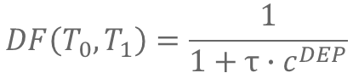

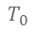


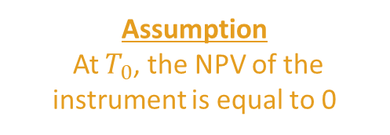
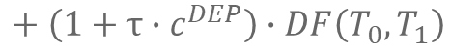
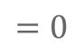
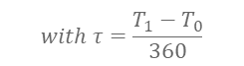
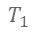
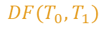
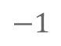
Certificate of Deposit
$$t_{q}^{Quote}$$
+1
$$+τ∙c^{DEP}$$
$$with τ=\frac{T_{1}−T_{0}}{360}$$
$$T_{0}$$
-1
$$T_{1}$$
$$DF(T_{0},T_{1})$$
Assumption
At $T_{0}$, the NPV of the instrument is equal to 0
By Cashflow Replication
$$⇒$$
$$−1$$
$$+ \left(1+τ∙c^{DEP}\right)∙DF\left(T_{0},T_{1}\right)$$
$$=0$$
$$DF\left(T_{0},T_{1}\right)=\frac{1}{1+τ∙c^{DEP}}$$
Discount Factor Analytical Formula for Deposit
II. Bootstrapping Theory c) Instruments Definition

Slide 12
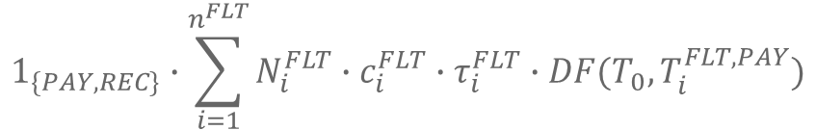

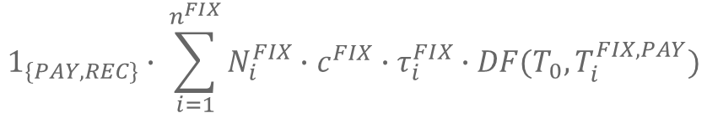
OIS NPV – General Fixed-Floating Swap Case
$$NPV^{OIS}=NPV^{FIX}+NPV^{FLT}$$
FIXED LEG NPV | FLOATING LEG NPV
Cashflow Accrual Period
Number of cashflows
Position Side (i.e. $±)$
$$1_{\{PAY,REC\}}∙ \sum_{i=1}^{n^{FIX}}{N_{i}^{FIX}∙c^{FIX}∙τ_{i}^{FIX}∙DF(T_{0},T_{i }^{FIX, PAY})}$$
$$1_{\{PAY,REC\}}∙\sum_{i=1}^{n^{FLT}}{N_{i}^{FLT}∙c_{i}^{FLT}∙τ_{i}^{FLT}∙DF(T_{0},T_{i }^{FLT,PAY})}$$
Fixed Coupon Rate/Market Quote
Discount Factor to Cashflow Payment Date
Notional
Floating Rate
II. Bootstrapping Theory c) Instruments Definition

Slide 13

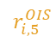

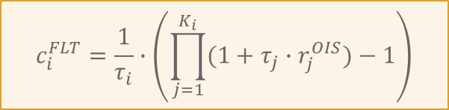
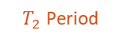

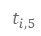
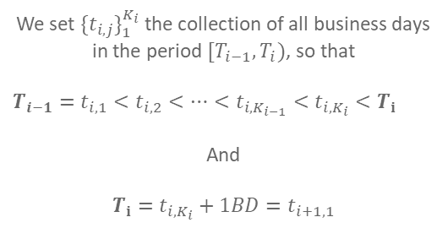
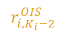
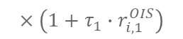
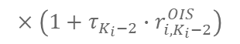
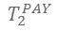

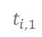
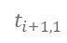

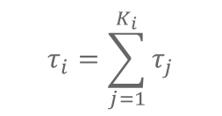
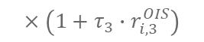

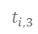
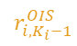
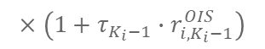

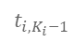
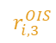
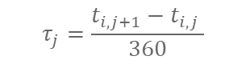
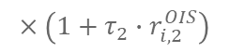


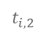
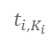
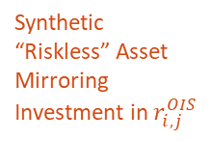
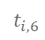
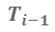
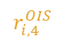






OIS Floating Rate Introduction
$T_{2}$ Period
We set ${\{t_{i,j}\}}_{1}^{K_{i}}$the collection of all business days in the period $[T_{i−1},T_{i})$, so that
$$T_{i−1}=t_{i,1}<t_{i,2}<…<t_{i,K_{i−1}}<t_{i,K_{i}}<T_{i}$$
And
$$T_{i}=t_{i,K_{i}}+1BD=t_{i+1,1}$$
$$T_{0}$$
$$T_{Spot}$$
$$T_{1}$$
$$T_{1}^{PAY}$$
$$T_{2}$$
$$T_{2}^{PAY}$$
…
$$T_{n−1}$$
$$T_{n−1}^{PAY}$$
$$T_{n}$$
$$T_{n}^{PAY}$$
$$r_{i,2}^{OIS}$$
$$r_{i,3}^{OIS}$$
$$r_{i,4}^{OIS}$$
$$r_{i,K_{i}}^{OIS}$$
$$r_{i,1}^{OIS}$$
$$r_{i,5}^{OIS}$$
$$r_{i,K_{i}−2}^{OIS}$$
$$r_{i,K_{i}−1}^{OIS}$$
$$T_{i−1}$$
…
$$T_{i}$$
$$t_{i−1,K_{i−1}}$$
$$t_{i,1}$$
$$t_{i,2}$$
$$t_{i,3}$$
$$t_{i,4}$$
$$t_{i,5}$$
$$t_{i,6}$$
$$t_{i,K_{i}−1}$$
$$t_{i,K_{i}}$$
$$t_{i+1,1}$$
Synthetic “Riskless” Asset Mirroring Investment in $r_{i,j}^{OIS}$
$$B\left(T_{i−1},T_{i}\right)=1$$
$$×\left(1+τ_{1}∙r_{i,1}^{OIS}\right)$$
$$×\left(1+τ_{2}∙r_{i,2}^{OIS}\right)$$
$$×\left(1+τ_{3}∙r_{i,3}^{OIS}\right)$$
$$×…$$
$$×\left(1+τ_{K_{i}−2}∙r_{{i,K}_{i}−2}^{OIS}\right)$$
$$×\left(1+τ_{K_{i}−1}∙r_{{i,K}_{i}−1}^{OIS}\right)$$
$$×\left(1+τ_{K_{i}}∙r_{{i,K}_{i}}^{OIS}\right)$$
$$B\left(T_{i−1},T_{i}\right)=\prod_{j=1}^{K_{i}}{(1+τ_{j}∙r_{j}^{OIS})}$$
$$τ_{j}=\frac{t_{i,j+1}−t_{i,j} }{360}$$
$$⟺$$
With
$$Abuse of Notation:$$
$${if i=1, T}_{i−1}=T_{Spot} not T_{0}$$
OIS floating rate $c_{i}^{FLT}$is calculated using the geometric mean of the daily OIS rates for the period
$$c_{i}^{FLT}=\frac{1}{τ_{i}}∙\left(\prod_{j=1}^{K_{i}}{(1+τ_{j}∙r_{j}^{OIS})}−1\right)$$
$$τ_{i}=\sum_{j=1}^{K_{i}}{τ_{j}}$$
$$⇒$$
with
OIS Floating Rate Formula
II. Bootstrapping Theory c) Instruments Definition

Slide 14





OIS NPV – Current Bootstrapping Case
Assumption 1 – Both legs have exactly same cashflow schedule/conventions, with:
Calendar set to TARGET (Trans-European Automated Real-time Gross-settlement Express Transfer system)
Notional amount set to 1
Day Count convention set to Actual/360
Payment lag set to 1 Business Day
$$N_{i}^{FIX}=N_{i}^{FLT}$$
$$=1$$
$$n^{FIX}=n^{FLT}=n$$
$$=\frac{T_{i}−T_{i−1}}{360}$$
$$τ_{i}^{FIX}=τ_{i}^{FLT}=τ_{i}$$
$$T_{i}^{FIX,PAY}=T_{i}^{FLT,PAY}=T_{i}^{PAY}$$
$$=T_{i}+1BD$$
II. Bootstrapping Theory c) Instruments Definition

Slide 15






















OIS NPV – Current Bootstrapping Case
$$t_{q}^{Quote}$$
1BD
1BD
$$+τ_{1}∙c_{1}^{FLT}$$
$$if{ t}_{q}^{Quote}≤1Y$$
$$−τ_{1}∙c^{FIX}∙DF\left(T_{0},T_{1}^{PAY}\right)$$
$$+{ τ}_{1}∙c_{1}^{FLT}∙DF\left(T_{0},T_{1}^{PAY}\right)$$
$$T_{0}$$
$$T_{Spot}$$
$$T_{1}$$
$$T_{1}^{PAY}$$
$$−τ_{1}∙c^{FIX}$$
Fixed Leg
Floating Leg
$$DF(T_{0},T_{1}^{PAY})$$
$$t_{q}^{Quote}$$
$$1^{st}Accrued Period$$
$$1Y$$
$$−τ_{1}∙c^{FIX}∙DF\left(T_{0},T_{1}^{PAY}\right)$$
$$−τ_{2}∙c^{FIX}∙DF\left(T_{0},T_{2}^{PAY}\right)$$
$$+τ_{1}∙c_{1}^{FLT}$$
$$+τ_{2}∙c_{2}^{FLT}$$
$$if{ t}_{q}^{Quote}>1Y$$
1BD
1BD
1BD
Fixed Leg
$$T_{0}$$
$$T_{Spot}$$
$$T_{1}$$
$$T_{1}^{PAY}$$
$$T_{2}$$
$$T_{2}^{PAY}$$
$$+{ τ}_{1}∙c_{1}^{FLT}∙DF\left(T_{0},T_{1}^{PAY}\right)$$
$$+{ τ}_{2}∙c_{2}^{FLT}∙DF\left(T_{0},T_{2}^{PAY}\right)$$
$$−τ_{1}∙c^{FIX}$$
$$−τ_{2}∙c^{FIX}$$
$$DF(T_{0},T_{1}^{PAY})$$
Floating Leg
$$DF(T_{0},T_{2}^{PAY})$$
II. Bootstrapping Theory c) Instruments Definition
II. Bootstrapping Theory

Slide 16













OIS NPV – Current Bootstrapping Case
Assumption 1 – Both legs have exactly same cashflow schedule/conventions, with
Calendar set to TARGET (Trans-European Automated Real-time Gross-settlement Express Transfer system)
Notional amount set to 1
Day Count convention set to Actual/360
Payment lag set to 1 Business Day
Fixed Leg
Floating Leg
$$−τ_{1}∙c^{FIX}∙DF\left(T_{0},T_{1}^{PAY}\right)$$
$$+{ τ}_{1}∙c_{1}^{FLT}∙DF\left(T_{0},T_{1}^{PAY}\right)$$
$$N_{i}^{FIX}=N_{i}^{FLT}=1$$
$$−τ_{2}∙c^{FIX}∙DF\left(T_{0},T_{2}^{PAY}\right)$$
$$+{ τ}_{2}∙c_{2}^{FLT}∙DF\left(T_{0},T_{2}^{PAY}\right)$$
$$n^{FIX}=n^{FLT}=n$$
$$−τ_{3}∙c^{FIX}∙DF\left(T_{0},T_{3}^{PAY}\right)$$
$$+{ τ}_{3}∙c_{3}^{FLT}∙DF\left(T_{0},T_{3}^{PAY}\right)$$
$$T_{i}^{FIX,PAY}=T_{i}^{FLT,PAY}=T_{i}^{PAY}=T_{i}+1BD$$
$$…$$
$$…$$
$$τ_{i}^{FIX}=τ_{i}^{FLT}=τ_{i}=\frac{T_{i}−T_{i−1}}{360}$$
$$−τ_{n−1}∙c^{FIX}∙DF\left(T_{0},T_{n−1}^{PAY}\right)$$
$$+{ τ}_{n−1}∙c_{n−1}^{FLT}∙DF\left(T_{0},T_{n−1}^{PAY}\right)$$
$$−τ_{n}∙c^{FIX}∙DF\left(T_{0},T_{n}^{PAY}\right)$$
$$+{ τ}_{n}∙c_{n}^{FLT}∙DF\left(T_{0},T_{n}^{PAY}\right)$$
=
$$−\sum_{i=1}^{n}{c^{FIX}∙τ_{i}∙DF(T_{0},T_{i }^{PAY})}$$
$$+\sum_{i=1}^{n}{c_{i}^{FLT}∙τ_{i}∙DF(T_{0},T_{i }^{PAY})}$$
II. Bootstrapping Theory c) Instruments Definition

Slide 17




OIS NPV – Current Bootstrapping Case
Assumption 1 – Both legs have exactly same cashflow schedule/conventions, with
Calendar set to TARGET (Trans-European Automated Real-time Gross-settlement Express Transfer system)
Notional amount set to 1
Day Count convention set to Actual/360
Payment lag set to 1 Business Day
$${NPV }^{FIX}= \sum_{i=1}^{n}{c^{FIX}∙τ_{i}∙DF\left(T_{0},T_{i}^{PAY}\right)}$$
$$N_{i}^{FIX}=N_{i}^{FLT}=1$$
$$n^{FIX}=n^{FLT}=n$$
$$=c^{FIX}∙\sum_{i=1}^{n}{τ_{i}∙DF\left(T_{0},T_{i}^{PAY}\right)}$$
$$T_{i}^{FIX,PAY}=T_{i}^{FLT,PAY}=T_{i}^{PAY}=T_{i}+1BD$$
$$τ_{i}^{FIX}=τ_{i}^{FLT}=τ_{i}=\frac{T_{i}−T_{i−1}}{360}$$
$${NPV }^{FLT}=\sum_{i=1}^{n}{c_{i}^{FLT}∙τ_{i}∙DF(T_{0},T_{i}^{PAY})}$$
Assumption 2 – At $T_{0}$, the NPV of the Swap is equal to 0
$$c^{Fix}=\frac{\sum_{i=1}^{n}{c_{i}^{FLT}∙τ_{i}∙DF(T_{0},T_{i}^{PAY})}}{\sum_{i=1}^{n}{τ_{i}∙DF(T_{0},T_{i}^{PAY})}}$$
$${NPV }^{FIX}={NPV }^{FLT}$$
Swap Rate Formula
II. Bootstrapping Theory b) Instruments Definition

Slide 18
II Bootstrapping Theory
d) Bootstrapping Detailed Explanation

Slide 19





OIS Floating Rate - Calculations Summary
In the context of an OIS Instrument Valuation, the OIS floating rate $c_{i}^{FLT}$is calculated using the geometric mean of the daily OIS rates for the period , like below:
$$c_{i}^{FLT}=\frac{1}{τ_{i}}∙\left(\prod_{j=1}^{K_{i}}{(1+τ_{j}∙r_{j}^{OIS})}−1\right)$$
When equating the overnight rate to the short rate, we obtain a more mathematically convenient expression.
$$≅ \frac{1}{τ_{i}}∙\left(e^{\int_{T_{i}}^{T_{i}+1}{r\left(t\right)dt}}−1\right)$$
With ${\{t_{i,j}\}}_{j}^{K_{i}}$the collection of all business days in the period $[T_{i−1},T_{i})$,
so that $T_{i−1}=t_{i,1}<t_{i,2}<…<t_{i,K_{i}}<T_{i}$ and $T_{i}=t_{i,K_{i}}+1BD=t_{i+1,1}$
In the context of OIS Curve Bootstrapping, we only have information about the OIS quotes and the discount factors we already built (i.e. up to $T_{i−1}$):
$$c_{i}^{FLT}=\frac{\frac{DF\left(T_{0} ,T_{i−1}\right)}{DF\left(T_{0},T_{i}\right)}−1}{τ_{i}}$$
$$c_{i}^{FLT}=\frac{\frac{DF\left(T_{0} ,T_{i−1}\right)}{DF\left(T_{0},T_{i}\right)}−1}{τ_{i}}$$
OIS Floating Rate Formula (for Bootstrapping)
II. Bootstrapping Theory d) Bootstrapping Explanation

Slide 20
























OIS Compounding Rate – Alternative Equations
Number of Compounding Periods / Number of Business Days between $T_{0}$and $T_{i}$
With
$$τ_{j}=\frac{t_{i,j+1}−t_{i,j} }{360}$$
and
$$K_{T_{i}}−K_{T_{i−1}}=K_{i}$$
$$K_{T_{i}}$$
OIS Rate over the compounding period
We discretise $T$
A synthetic asset
$$T_{0}$$
$$T_{i}$$
$r_{j}^{OIS}$ $∙\left(t_{i,j}−t_{i,j−1}\right)$
$$B$$
$$B(T_{0},T_{i})=N∙\prod_{j=1}^{K_{T_{i}}}{\left(1+τ_{j}∙r_{j}^{OIS}\right)}$$
$$⇒$$
$$FV(0,T)=P∙\prod_{j=1}^{K_{T}}{{\left(1+\frac{r_{j}}{n}\right)}^{n∙t_{j}}}$$
Daily Frequency
$$\frac{1}{360}$$
$${\left(1+\frac{1\%}{360}\right)}^{3}$$
$$=N∙\prod_{j=1}^{K_{T_{i−1}}}{\left(1+τ_{j}∙r_{j}^{OIS}\right)}∙\prod_{j=1}^{K_{T_{i}}−K_{T_{i−1}}}{\left(1+τ_{j}∙r_{j}^{OIS}\right)}$$
$$360$$
Number of Compounding Periods per Year
$${\left(1+\frac{1\%×3}{360}\right)}^{1}$$
Notional
$$N$$
1 Business Day
$$B\left(T_{0},T_{i}\right) =B\left(T_{0},T_{i−1}\right)∙\prod_{j=1}^{K_{i}}{\left(1+τ_{j}∙r_{j}^{OIS}\right)}$$
In a Deterministic Arbitrage-Free World
$$B\left(T_{0},T_{i}\right)∙DF\left(T_{0},T_{i}\right)=1$$
$$\prod_{j=1}^{K_{i}}{\left(1+τ_{j}∙r_{j}^{OIS}\right)}$$
$$DF\left(T_{0},T_{i}\right)=\frac{1}{B(T_{0},T_{i})}$$
$$\frac{B\left(T_{0},T_{i}\right)}{B\left(T_{0},T_{i−1}\right)}=$$
$$=\frac{DF\left(T_{0},T_{i−1}\right)}{DF\left(T_{0},T_{i}\right)}$$
$$B\left(T_{i−1},T_{i}\right)=$$
$$=DF\left(T_{i−1},T_{i}\right)$$
OIS Compounding Rate - Equivalence Formula
II. Bootstrapping Theory d) Bootstrapping Explanation

Slide 21









OIS Floating Leg Calculation
$$c_{i}^{FLT}=\frac{\frac{DF\left(T_{0} ,T_{i−1}\right)}{DF\left(T_{0},T_{i}\right)}−1}{τ_{i}}$$
$${NPV }^{FLT}=\sum_{i=1}^{n}{c_{i}^{FLT}∙τ_{i}^{FLT}∙DF\left(T_{0},T_{i }^{PAY}\right)}$$
with
$${NPV }^{FLT}=\sum_{i=1}^{n}{\left(\frac{DF\left(T_{0} ,T_{i−1}\right)}{DF\left(T_{0},T_{i}\right)}−1\right)∙DF\left(T_{0},T_{i}\right)}$$
OIS Floating Leg NPV
-
Trivial/Analytical Case
$$=\sum_{i=1}^{n}{DF\left(T_{0} ,T_{i−1}\right)−DF\left(T_{0},T_{i}\right)}$$
$$if T_{i }^{PAY}=T_{i}$$
$$⇒$$
$${NPV }^{FLT}=1−DF\left(T_{0},T_{n}\right)$$
OIS Floating Leg NPV
-
Real-World/Root-Finding Case
$${NPV }^{FLT}=\sum_{i=1}^{n}{\left(\frac{DF\left(T_{0} ,T_{i−1}\right)}{DF\left(T_{0},T_{i}\right)}−1\right)∙DF\left(T_{0},T_{i }^{PAY}\right)}$$
$$if T_{i }^{PAY}>T_{i}$$
II. Bootstrapping Theory d) Bootstrapping Explanation

Slide 22








Bootstrapping – Analytical Case
$${NPV }^{FIX}=c^{FIX}∙\sum_{i=1}^{n}{τ_{i}∙DF\left(T_{0},T_{i}\right)}$$
$${NPV }^{FLT}=1−DF\left(T_{0},T_{n}\right)$$
$$c^{FIX}∙\sum_{i=1}^{n}{τ_{i}∙DF\left(T_{0},T_{i}\right)}=1−DF\left(T_{0},T_{n}\right)$$
$$⇒$$
$$DF\left(T_{0},T_{n}\right)=1−c^{FIX}\sum_{i=1}^{n−1}{τ_{i}∙DF\left(T_{0},T_{i}\right)}$$
$$⇔$$
$$−c^{FIX}∙τ_{n}∙DF\left(T_{0},T_{n}\right)$$
$$DF\left(T_{0},T_{n}\right)=\frac{1−c^{FIX}\sum_{i=1}^{n−1}{τ_{i}∙DF\left(T_{0},T_{i}\right)}}{1+c^{FIX}∙τ_{n}}$$
Discount Factor Analytical Formula for OIS
$$⇔$$
$$if n=1 then DF\left(T_{0},T_{n}\right)=\frac{1}{1+c^{FIX}∙τ_{n}}$$
Note:
Same formula as a Deposit
II. Bootstrapping Theory d) Bootstrapping Explanation

Slide 23




















Bootstrapping – Root-Finding Case
Discount Factor Root-Finding Formula for Fixed-Floating Swap
OBJECTIVE
NOTATIONS
$$DF\left(T_{0},T_{n}^{PAY}\right)$$
$$τ_{i}=\frac{T_{i}−T_{i−1}}{360}$$
FIND
$$x$$
At time $t_{n}$, we have information up to $n−1$ on discount factor data
$$\left|\frac{\sum_{i=1}^{n}{c_{i}^{FLT}∙τ_{i}∙DF(T_{0},T_{i}^{PAY})}}{\sum_{i=1}^{n}{τ_{i}∙DF(T_{0},T_{i}^{PAY})}}−c^{FIX}\right|≤ε$$
$$\frac{\sum_{i=1}^{n}{c_{i}^{FLT}∙τ_{i}∙DF(T_{0},T_{i}^{PAY})}}{\sum_{i=1}^{n}{τ_{i}∙DF(T_{0},T_{i}^{PAY})}}−c^{FIX} = 0$$
$$τ_{i}^{PAY}=\frac{T_{i}^{PAY}−T_{i}}{360}$$
SUCH THAT
$${NPV }^{FIX}−{NPV }^{FLT}=0$$
INFORMATION
$$f\left(x\right)=0$$
# | Instrument Type | Discount Factor Data | Known
0 | / | $$DF(T_{0},T_{0})$$
1 | Deposit | $$DF(T_{0},T_{1})$$
2 | OIS | $$DF(T_{0},T_{2}^{PAY})$$
… | OIS | …
n-1 | OIS | $$DF(T_{0},T_{n−1}^{PAY})$$
n | OIS | $$DF(T_{0},T_{n}^{PAY})$$
n+1 | OIS | $$DF(T_{0},T_{n+1}^{PAY})$$
UNDERLYING CALCULATIONS
$$\sum_{i=1}^{n}{c_{i}^{FLT}∙τ_{i}∙DF(T_{0},T_{i}^{PAY})}=\sum_{i=1}^{n−1}{c_{i}^{FLT}∙τ_{i}∙DF\left(T_{0},T_{i}^{PAY}\right)}+c_{n}^{FLT}∙τ_{n}∙DF\left(T_{0},T_{n}^{PAY}\right)$$
Regressed Variable
$$c_{i}^{FLT}=\frac{\frac{DF\left(T_{0} ,T_{i−1}\right)}{DF\left(T_{0},T_{i}\right)}−1}{τ_{i}}$$
$$c_{n}^{FLT}=\frac{\frac{DF\left(T_{0},T_{n−1}\right)}{DF\left(T_{0},T_{n}\right)}−1}{τ_{n}}$$
WITH
AND
$$DF\left(T_{0},T_{n}\right)=\exp\left(\log\left(DF\left({T_{0},T}_{n−1}\right)\right)+\log\left(\frac{DF\left(T_{0},T_{n}^{PAY}\right)}{DF\left(T_{0},T_{n−1}\right)}\right)∙\frac{τ_{n}}{τ_{n}^{PAY}}\right)$$
AND
II. Bootstrapping Theory d) Bootstrapping Explanation

Slide 24



















Log-Linear Interpolation
Here is the formula for the log-linear interpolation of discount factors:
$$y\left(t\right)=\exp\left(\log\left(y\left(t_{i−1}\right)\right)+\log\left(\frac{y\left(x_{i}\right)}{y\left(x_{i−1}\right)}\right)∙\frac{x−x_{i−1}}{x_{i}−x_{i−1}}\right)$$
Applied to our case:
$$⇒$$
$$DF\left(T_{0},T_{n}\right)=\exp\left(\log\left(DF\left({T_{0},T}_{n−1}\right)\right)+\log\left(\frac{DF\left(T_{0},T_{n}^{PAY}\right)}{DF\left(T_{0},T_{n−1}\right)}\right)∙\frac{T_{n}−T_{n−1}}{T_{n}^{PAY}−T_{n−1}}\right)$$
$$DF(T_{0},T_{i})$$
$$\hat{DF(T_{0},T_{n}^{PAY}) }$$
$$DF(T_{0},T_{n}^{PAY})$$
$$\hat{DF(T_{0},T_{n})}$$
$$DF(T_{0},T_{n})$$
$$\hat{DF(T_{0},T_{n}^{PAY}) }$$
$$\hat{DF(T_{0},T_{n})}$$
$$DF(T_{0},T_{n−1})$$
…
$$DF\left(T_{0},T_{1}\right)$$
$$DF\left(T_{0},T_{0}\right)=1$$
$$T_{i}$$
$$T_{1}$$
$$T_{0}$$
$$…$$
$$T_{n−1}$$
$$T_{n}$$
$$T_{n}^{PAY}$$
II. Bootstrapping Theory d) Bootstrapping Explanation

Slide 25







Bootstrapping – Z-Spread Curve
$$DF\left(T_{0},T_{i}\right) ∀i∈[0;n]$$
$$r\left(T_{0},T_{i}\right)=−\frac{\ln\left(DF\left(T_{0},T_{i}\right)\right)}{τ_{i}} ∀i∈\left[1;n\right]$$
$${DF}^{Z−Spread}=\exp\left(−r^{Z−Spread}\left(T_{0},T_{i}\right)∙τ_{i}\right) ∀i∈\left[0;n\right]$$
$$r^{Z−Spread}\left(T_{0},T_{i}\right)=r\left(T_{0},T_{i}\right)+z ∀i∈\left[1;n\right]$$
II. Bootstrapping Theory d) Bootstrapping Explanation

